Slide 1
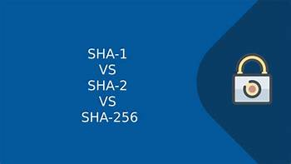
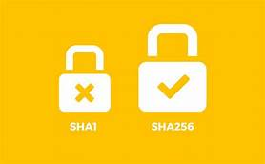
Topic name: -Difference between sha1 and sha-256 Algorithm
Mini Project 1B
Group 6
Internal guide name: -Mrs. Sonali Deshpande maam (hod)
Name: -Namrata khilari roll no: -29
name: -Samrudhi patil roll no: -51 (leader)
Name: -roshani surwade roll no: -67

Slide 2

Introduction of SHA Algorithm: -
SHA algorithm is Secure Hash algorithm developed by the National Institute of Standards and Technology along with NSA, previously released as a Federal Information Processing Standard, later in 1995, it was named as SHA algorithm, design to modify the MD4, in other words, we can say that the SHA algorithm is the modified version of MD4.
SHA is designed to obtain the original message, given its message digest, and find the message producing the same message.
What is SHA Algorithm: -
In the field of cryptography and crypt analytics, the SHA-1 algorithm is a crypt-formatted hash function that is used to take a smaller input and produces a string that is 160 bits, also known as 20-byte hash value long.
The hash value therefore generated, is known as a message digest which is typically rendered and produced as a hexadecimal number which is specifically 40 digits long.

Slide 3
Problem Statement
In 2012, some calculations showed how breaking SHA1 is becoming feasible for those who can afford it
Google’s decision complicates things: now it’s no longer safe to use SHA1 (with Google Chrome) even during 2016.
The news is that SHA1, a very popular hashing function, is on the way out.
SHA1 has also been deemed quite vulnerable to collision attacks which is why all browsers will be removing support for
certificates signed with SHA1 by January 2017.
Treat SHA1 signatures as weak and warn about them.
SHA2 is the successor of SHA1 and is commonly used by many SSL certificate authorities.
SHA256 however, is currently much more resistant to collision
attacks as it is able to generate a longer hash which is harder to break

Slide 4
Characteristics
The cryptographic hash functions are utilized and used to keep and store the secured form of data by providing three different kinds of characteristics such as pre-image resistance, which is also known as the first level of image resistance, the second level of pre-image resistance and collision resistance.
The cornerstone lies in the fact that the pre-image crypt resistance technique makes it hard and more time consuming for the hacker or the attacker to find the original intended message by providing the respective hash value.
The security, therefore, is provided by the nature of a one way that has a function that is mostly the key component of the SHA algorithm. The pre-image resistance is important to clear off brute force attacks from a set of huge and powerful machines.
Similarly, the second resistance technique is applied where the attacker has to go through a hard time decoding the next error message even when the first level of the message has been decrypted. The last and most difficult to crack is the collision resistance, making it extremely hard for the attacker to find two completely different messages which hash to the same hash value.
Therefore, the ratio to the number of inputs and the outputs should be similar in fashion to comply with the pigeonhole principle. The collision resistance implies that finding two different sets of inputs that hash to the same hash is extremely difficult and therefore marks its safety.

Slide 5
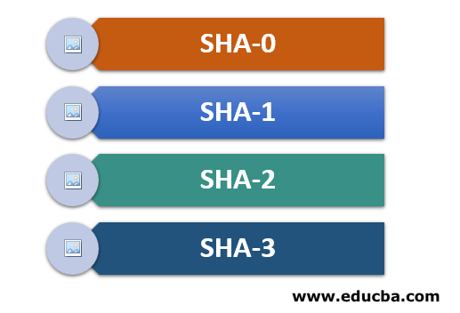
Types of SHA Algorithm
The Different Types of SHA algorithm include the ones:
1. SHA-0
It is a retronym that is applied to the basic version of the year-old 160 bit or 20-byte long hash function, which was published back in 1993 with the name of the SHA algorithm.
It was withdrawn very shortly after it was published due to a major flaw, and therefore SHA-1 came into the picture.

Slide 6
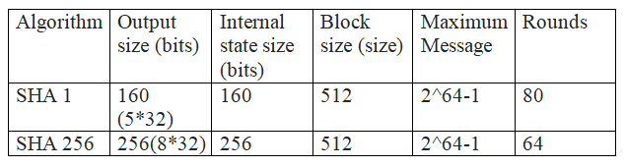
2. SHA-1
It is a 160 bit or a 20-byte long hash-based function-based encryption mechanism that is used to resemble the year-old MD5 algorithm.
The particular algorithm was designed and developed by the NSA, i.e. the National Security Agency and was supposed to be part of the critical component- Digital Signature Algorithm (DSA).
The weaknesses related to the cryptographic techniques were found in SHA-1; the encryption standard was later on discarded and was not much put to use.
3. SHA-2
This forms a family of 2 identical hash functions, which consist of differently sized block sizes which are known to be SHA-512 and SHA-256, which differ mainly in the word size.
The former consists of the word value range of 32 words, whereas the latter consists of the 64-bit word value.
The truncated versions of these values include SHA-224, SHA-384 and SHA-512 and SHA-224 or SHA-256.

Slide 7
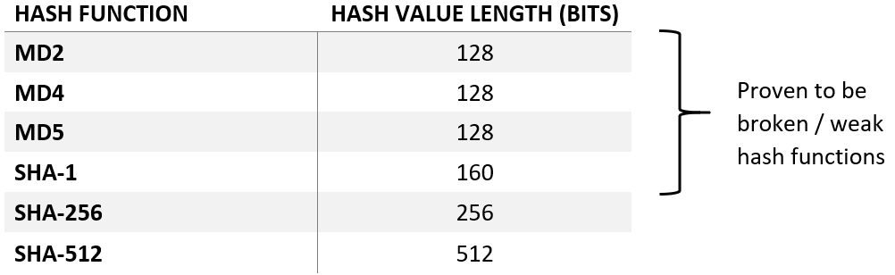
4. SHA-3
This is the encryption technique being used mainly today, which makes use of the hash function named Keccak.
The length supported is the same as that of SHA-2. Still, the majority of the difference lies in the fact that this one is structurally different as it is based on a wide range of random function generation, which typically supports all random permutations and thereby allowing inputting or absorbing, as it is called, any amount of data presented and outputting or squeezing the presented data.
While doing all this, this acts as a pseudorandom function for all the inputs provided, which therefore leads to greater flexibility.
https://replit.com/@samrudhihanmant/SHA-256#main.py

Slide 8
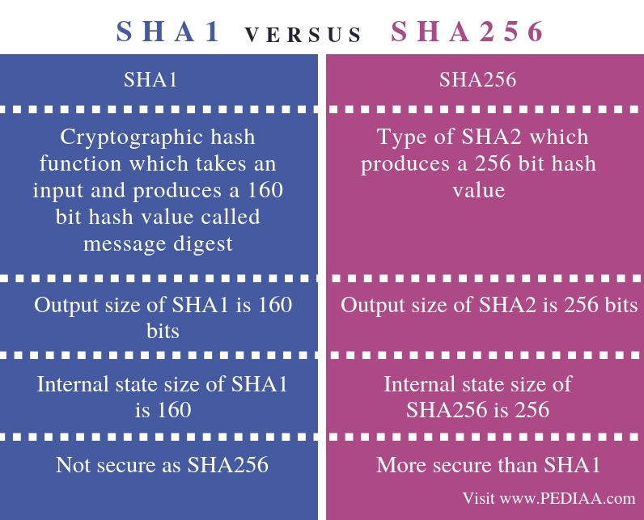

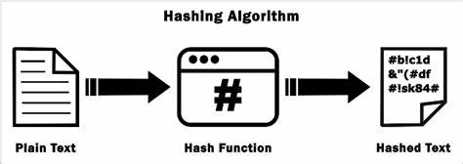
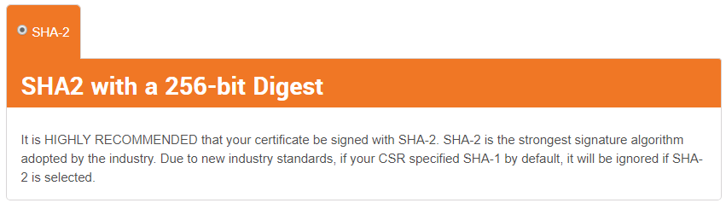
Difference Between SHA1 and SHA-256 Algorithm

Slide 9
SHA1 Algorithm Application
1. Cryptography
Further information: Cryptographic hash function § Applications
SHA-1 forms part of several widely used security applications and protocols, including TLS and SSL, PGP, SSH, S/MIME, and IPsec. Those applications can also use MD5; both MD5 and SHA-1 are descended from MD4.
SHA-1 and SHA-2 are the hash algorithms required by law for use in certain U.S. government applications, including use within other cryptographic algorithms and protocols, for the protection of sensitive unclassified information. FIPS PUB 180-1 also encouraged adoption and use of SHA-1 by private and commercial organizations.
SHA-1 is being retired from most government uses; the U.S. National Institute of Standards and Technology said, "Federal agencies should stop using SHA-1 for...applications that require collision resistance as soon as practical, and must use the SHA-2 family of hash functions for these applications after 2010" (emphasis in original), though that was later relaxed to allow SHA-1 to be used for verifying old digital signatures and time stamps.
A prime motivation for the publication of the Secure Hash Algorithm was the Digital Signature Standard, in which it is incorporated.
The SHA hash functions have been used for the basis of the SHACAL block ciphers.

Slide 10
2. Data integrity
Revision control systems such as Git, Mercurial, and Monotone use SHA-1, not for security, but to identify revisions and to ensure that the data has not changed due to accidental corruption. Linus Torvalds said about Git:
If you have disk corruption, if you have DRAM corruption, if you have any kind of problems at all, Git will notice them. It's not a question of if, it's a guarantee. You can have people who try to be malicious. They won't succeed. ... Nobody has been able to break SHA-1, but the point is the SHA-1, as far as Git is concerned, isn't even a security feature. It's purely a consistency check.
The security parts are elsewhere, so a lot of people assume that since Git uses SHA-1 and SHA-1 is used for cryptographically secure stuff, they think that, Okay, it's a huge security feature. It has nothing at all to do with security, it's just the best hash you can get. ...
I guarantee you, if you put your data in Git, you can trust the fact that five years later, after it was converted from your hard disk to DVD to whatever new technology and you copied it along, five years later you can verify that the data you get back out is the exact same data you put in. ...
One of the reasons I care is for the kernel, we had a break in on one of the Bit Keeper sites where people tried to corrupt the kernel source code repositories. However Git does not require the second preimage resistance of SHA-1 as a security feature, since it will always prefer to keep the earliest version of an object in case of collision, preventing an attacker from surreptitiously overwriting files.

Slide 11
SHA-256 Algorithm Application: -
The SHA-2 hash function is implemented in some widely used security applications and protocols, including TLS and SSL, PGP, SSH, S/MIME, and IPsec.
SHA-256 partakes in the process of authenticating Debian software packages and in the DKIM message signing standard; SHA-512 is part of a system to authenticate archival video from the International Criminal Tribunal of the Rwandan genocide.
SHA-256 and SHA-512 are proposed for use in DNSSEC.
Unix and Linux vendors are moving to using 256- and 512-bit SHA-2 for secure password hashing.
Several cryptocurrencies like Bitcoin use SHA-256 for verifying transactions and calculating proof of work or proof of stake.
The rise of ASIC SHA-2 accelerator chips has led to the use of crypt-based proof-of-work schemes.
SHA-1 and SHA-2 are the Secure Hash Algorithms required by law for use in certain U.S. Government applications, including use within other cryptographic algorithms and protocols, for the protection of sensitive unclassified information. FIPS PUB 180-1 also encouraged adoption and use of SHA-1 by private and commercial organizations. SHA-1 is being retired for most government uses; the U.S. National Institute of Standards and Technology says, "Federal agencies should stop using SHA-1 for...applications that require collision resistance as soon as practical, and must use the SHA-2 family of hash functions for these applications after 2010" (emphasis in original). NIST's directive that U.S. government agencies must stop uses of SHA-1 after 2010 was hoped to accelerate migration away from SHA-1.
The SHA-2 functions were not quickly adopted initially, despite better security than SHA-1.
Reasons might include lack of support for SHA-2 on systems running Windows XP SP2 or older and a lack of perceived urgency since SHA-1 collisions had not yet been found.
The Google Chrome team announced a plan to make their web browser gradually stop honouring SHA-1-dependent TLS certificates over a period from late 2014 and early 2015.

Slide 12
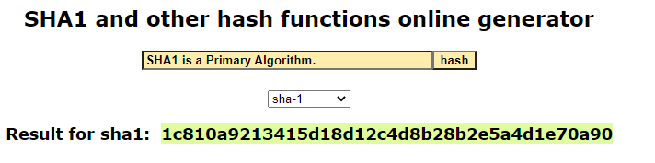
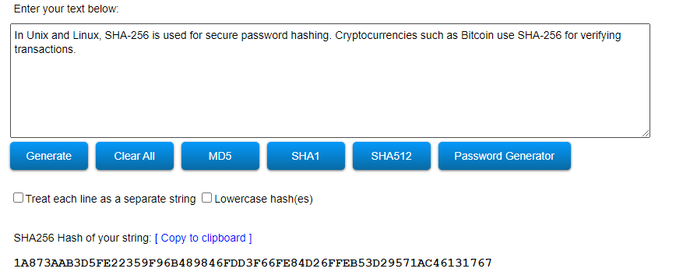
Similarly, Microsoft announced that Internet Explorer and Edge would stop honouring public SHA-1-signed TLS certificates from February 2017.
Mozilla disabled SHA-1 in early January 2016, but had to re-enable it temporarily via a Firefox update, after problems with web-based user interfaces of some router models and security appliances.

Slide 13
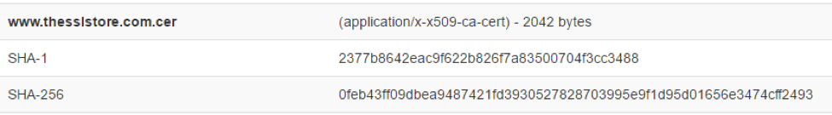
The SSL industry has picked SHA as its hashing algorithm for digital signatures
From 2011 to 2015, SHA-1 was the primary algorithm.
A growing body of research showing the weaknesses of SHA-1 prompted a revaluation.
In fact, Google has even gone so far as to create a SHA-1 collision (when two pieces of disparate data create the same hash value) just to provide.
So, from 2016 onward, SHA-2 is the new standard. If you are receiving an SSL/TLS certificate today it must be using that signature at a minimum.
Occasionally you will see certificates using SHA-2 384-bit.
You will rarely see the 224-bit variety, which is not approved for use with publicly trusted certificates, or the 512-bit variety which is less widely supported by software.
SHA-2 will likely remain in use for at least five years. However, some unexpected attack against the algorithm could be discovered which would prompt an earlier transition.
Here is what A SHA-1 and SHA-2 hash of our website’s SSL Certificate looks like:

Slide 14
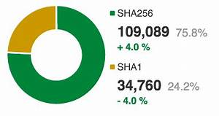
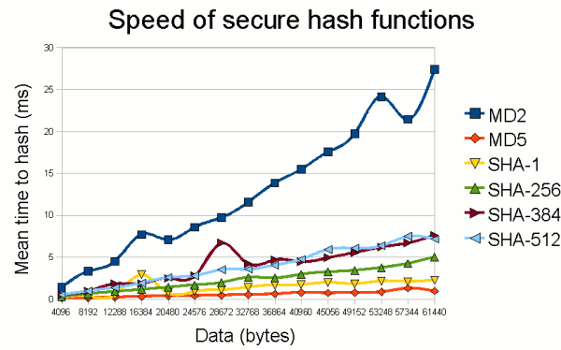
A larger bit hash can provide more security because there are more possible combinations.
Remember that one of the important functions of a cryptographic hashing algorithm is that is produces unique hashes. Again, if two different values or files can produce the same hash, you create what we call a collision.
The security of digital signatures can only be guaranteed as long as collisions do not occur.
Collisions are extremely dangerous because they allow two files to produce the same signature, thus, when a computer checks the signature, it may appear to be valid even though that file was never actually signed.
we found that in bit position of 2048,2047,2046,2045,2044 the probability of hash value before and after changing bits in previous position is less than 50% and from these Positions local collisions may
happen but in the proposed algorithm the probability is greater than 50%.
2. It is also clear that the security of this new algorithm is higher than SHA-256 and MD5 because even
if local collision happened in the middle of SHA second algorithm will fade it with an acceptable
diffusion so at the start of next round there are no equal states with previous round.

Slide 15
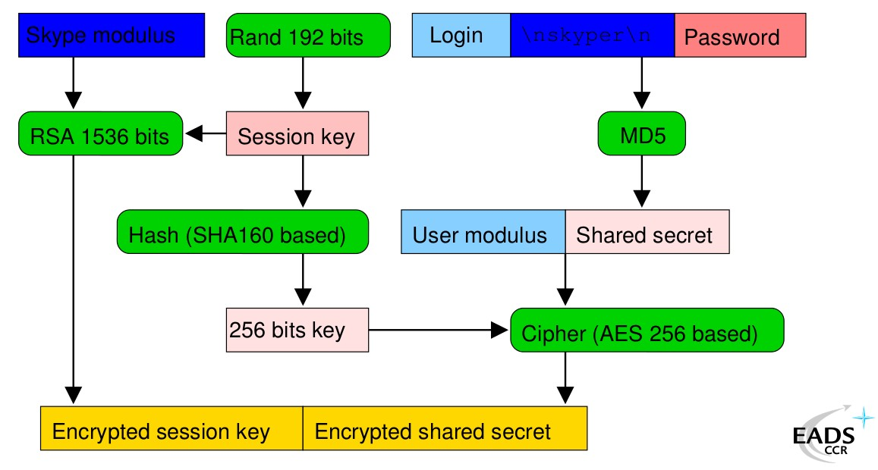

Digital Password: -
Password verification is a particularly important application for cryptographic hashing.
Storing users’ passwords in a plain-text document is a recipe for disaster; any hacker that manages to access the document would discover a treasure trove of unprotected passwords.
That’s why it’s more secure to store the hash values of passwords instead.
When a user enters a password, the hash value is calculated and then compared with the table.
If it matches one of the saved hashes, it’s a valid password and the user can be permitted access.
What role does SHA-256 hashing play in cybersecurity? SHA-256 is used in some of the most popular authentication and encryption protocols, including SSL, TLS, IPsec, SSH, and PGP.
In Unix and Linux, SHA-256 is used for secure password hashing. Cryptocurrencies such as Bitcoin use SHA-256 for verifying transactions.
https://replit.com/@samrudhihanmant/PASSWORD-1#main.py

Slide 16
CONCLUSIONS AND FUTURE WORK
we proposed a new secure hash algorithm based on the previous algorithms, MD5 and
SHA-256 that can be used in any message integrity or signing applications where its hash code length
is 256 bits. The complexity of the proposed hash algorithm is higher than that of SHA-256 and MD5.
The test results of the proposed algorithm show that its security is higher than that of SHA-256 and
MD5.The proposed algorithm passes the avalanche test and differential attack test with probability
greater than SHA-256.The proposed algorithm is immune to differential attack since the probability of
hash value before and after changing bits in previous position is greater than 50%.
We can extend our algorithm to have a bigger size of hash (512, 768 …) like SHAs by extending the
block size of compression functions or increasing number of them.

Slide 17


